Slide 1
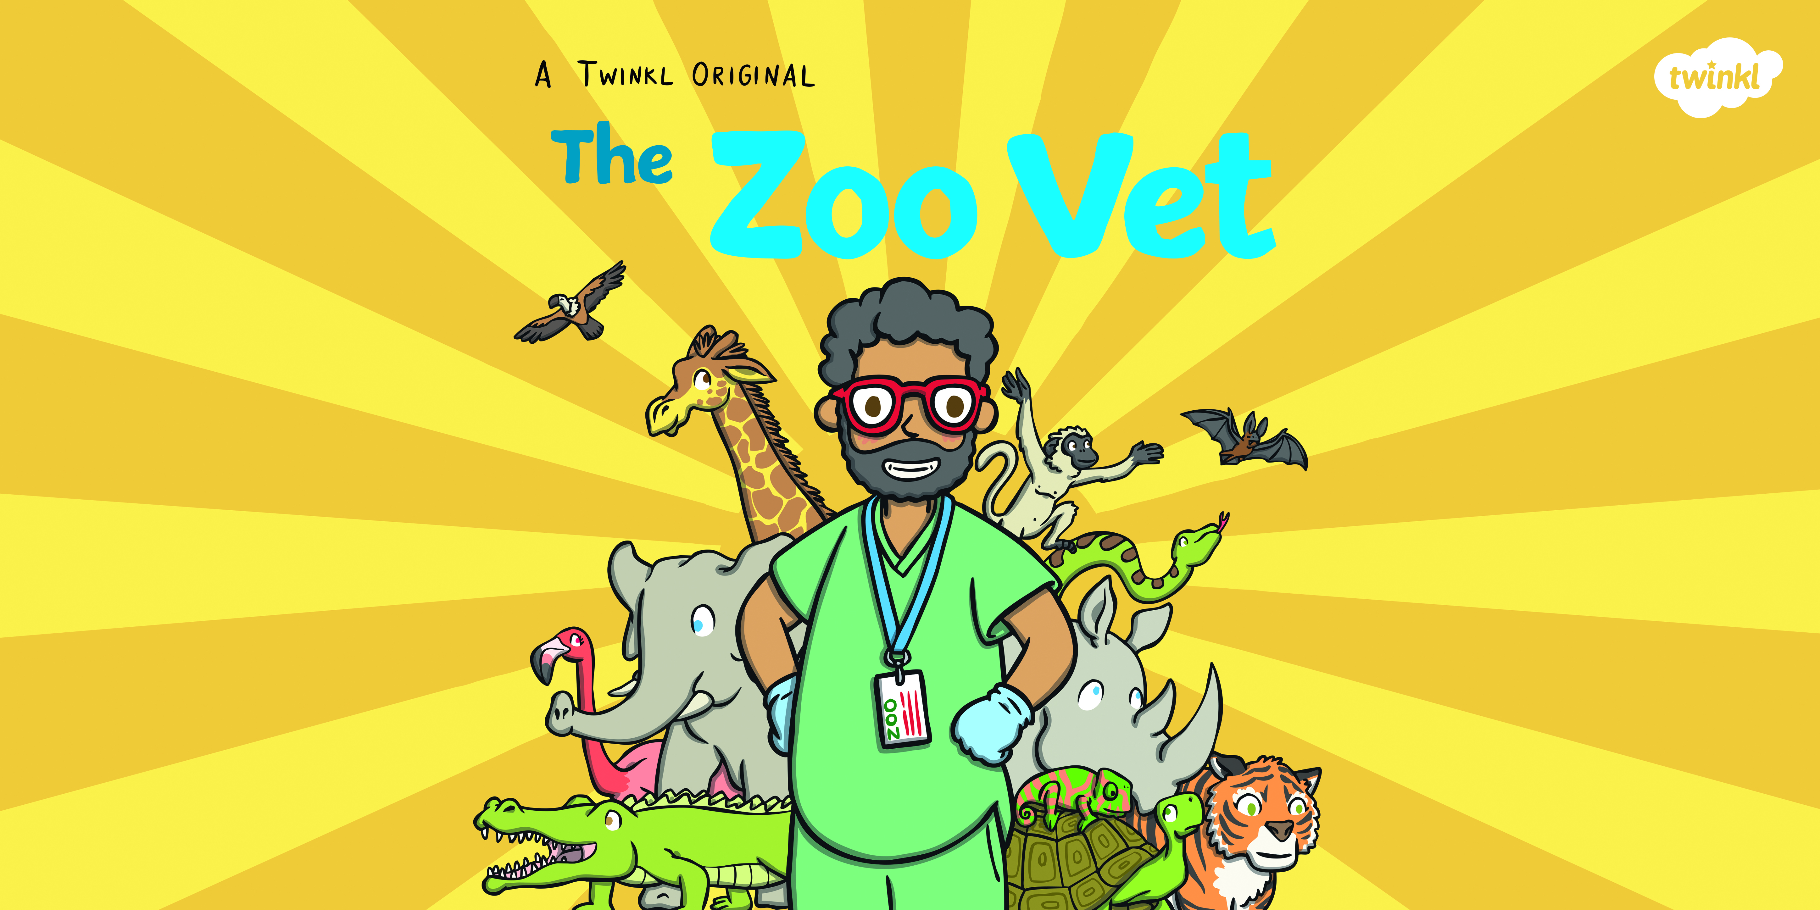

Slide 2
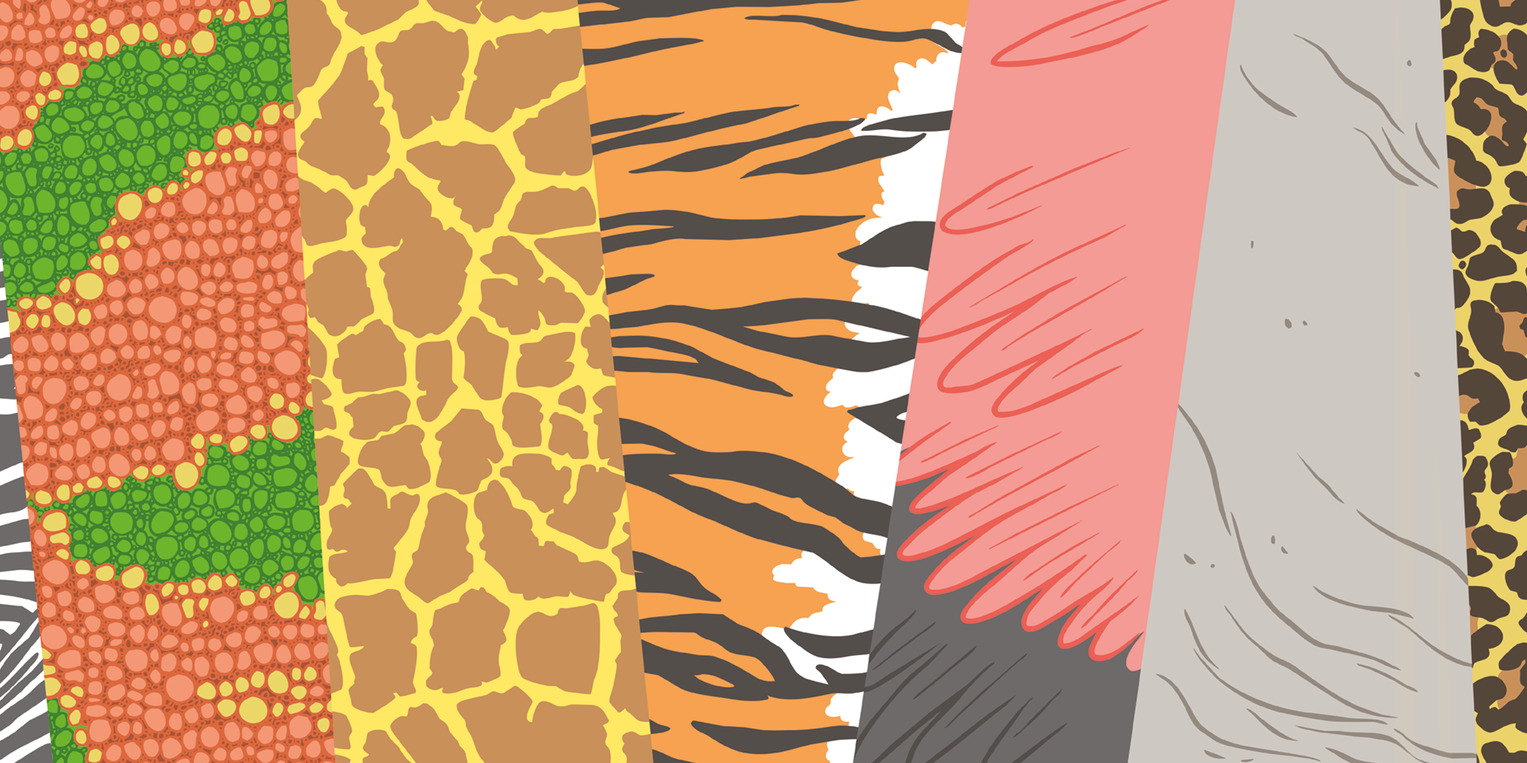

Slide 3
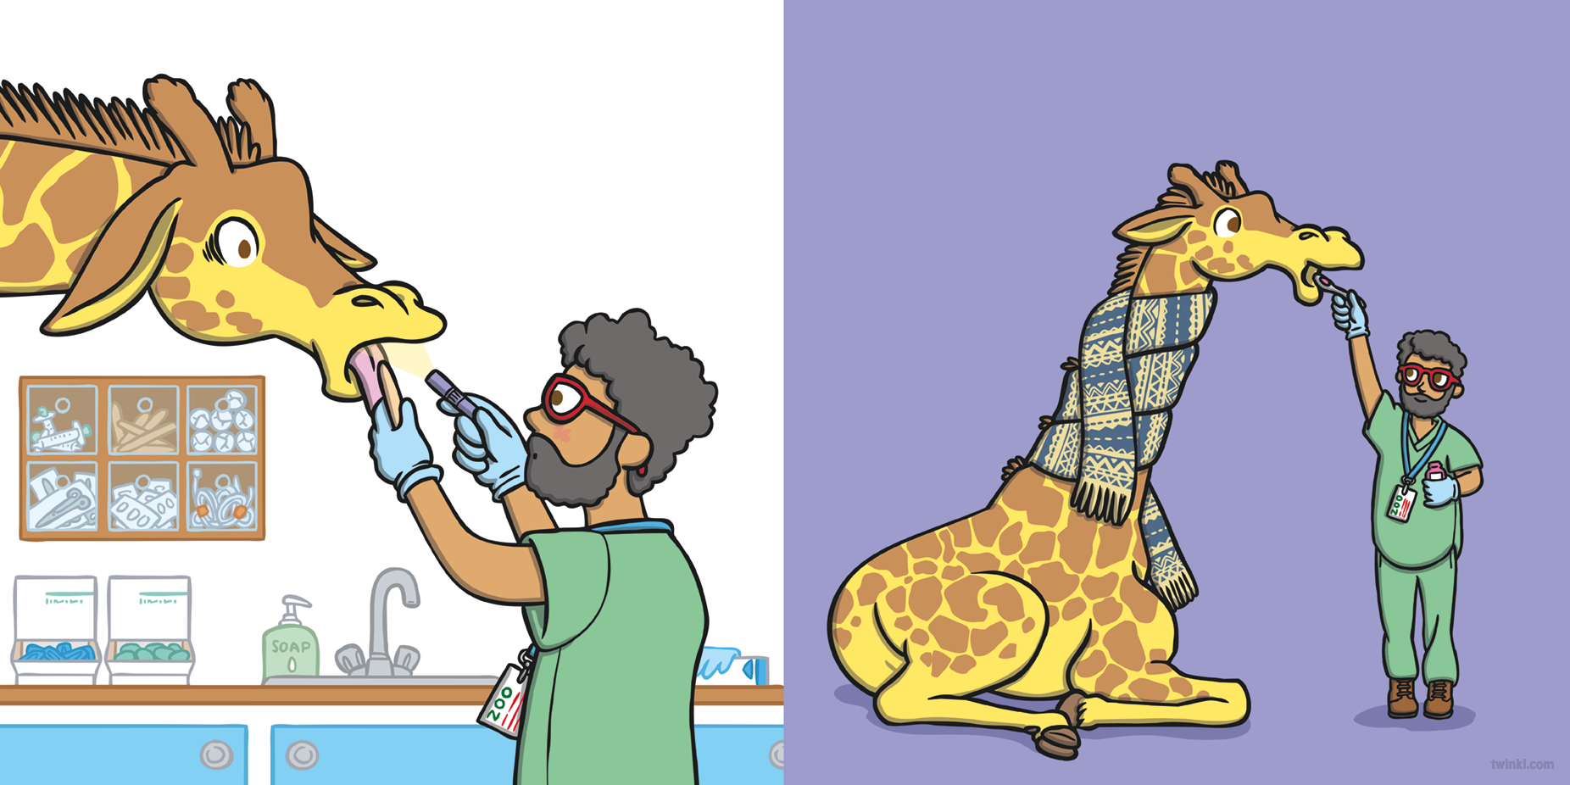
On Monday, George the giraffe visited the vet. He had a sore throat.
The vet gave George some medicine and a scarf to wrap around his neck.

Slide 4
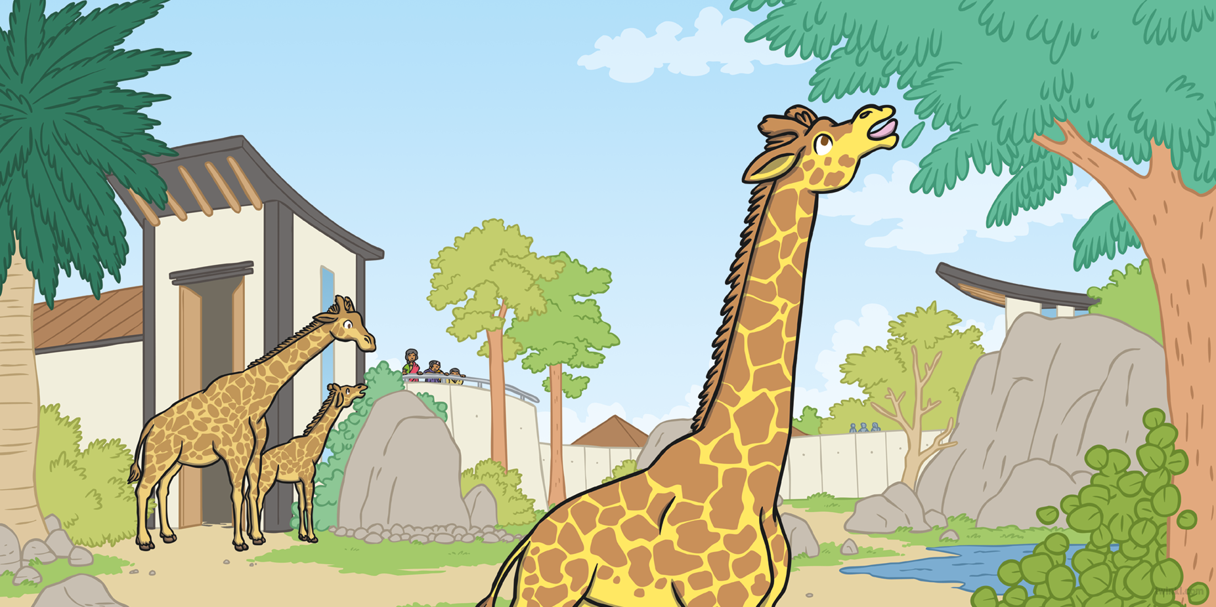
Thanks to the vet, the patient soon began to feel much better.

Slide 5
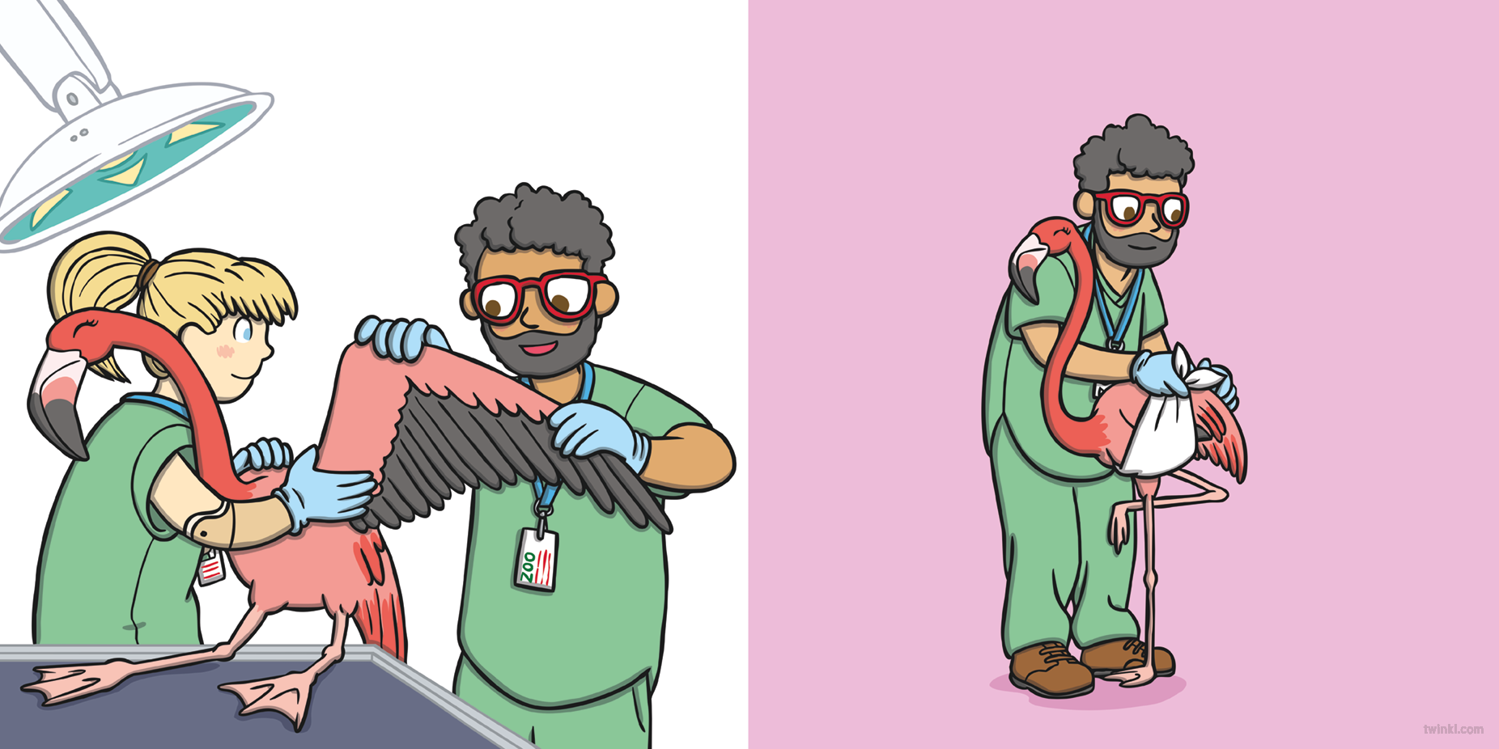
On Tuesday, Fatima the flamingo visited the vet. She had a broken wing.
The vet bandaged Fatima’s wing and put it into a sling.

Slide 6
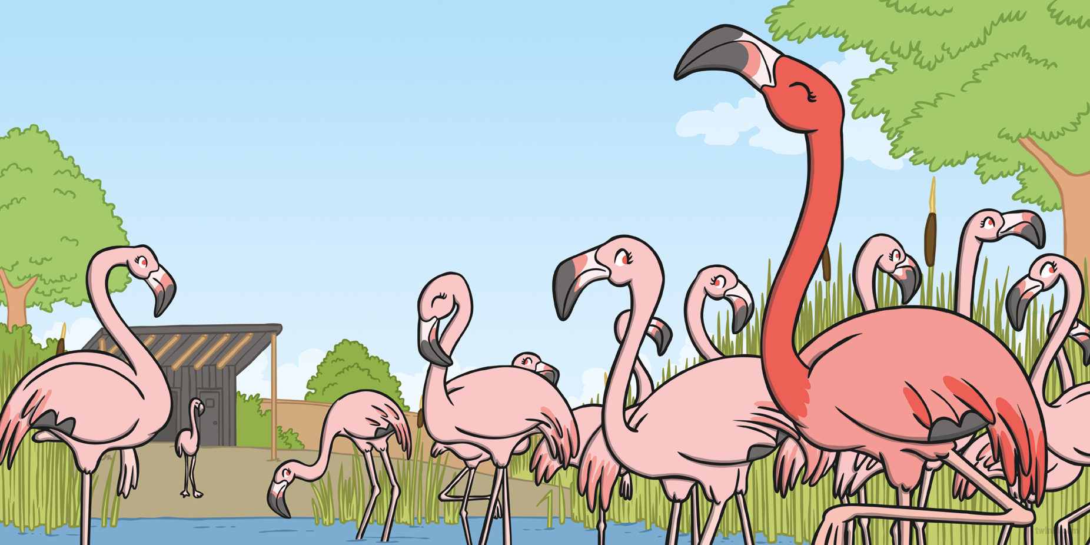
Thanks to the vet, the patient soon began to feel much better.

Slide 7
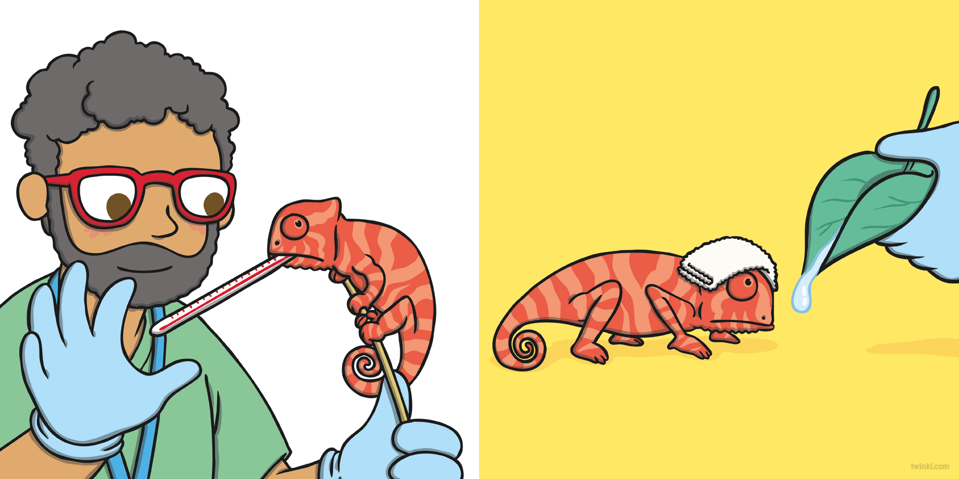
On Wednesday, Cam the chameleon visited the vet. He had a temperature.
The vet put a cool flannel on Cam’s head and gave him plenty of water to drink.

Slide 8
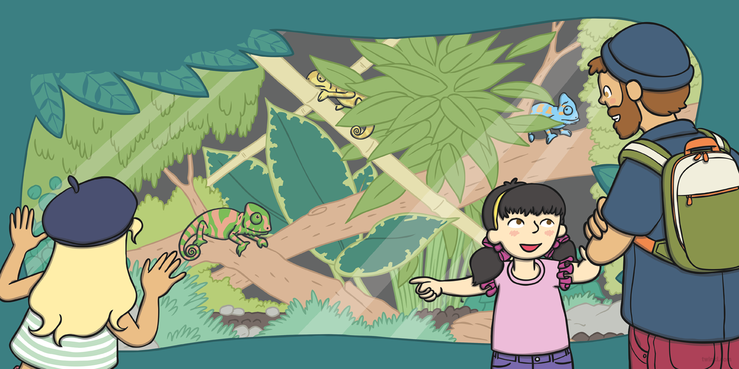
Thanks to the vet, the patient soon
began to feel much better.

Slide 9
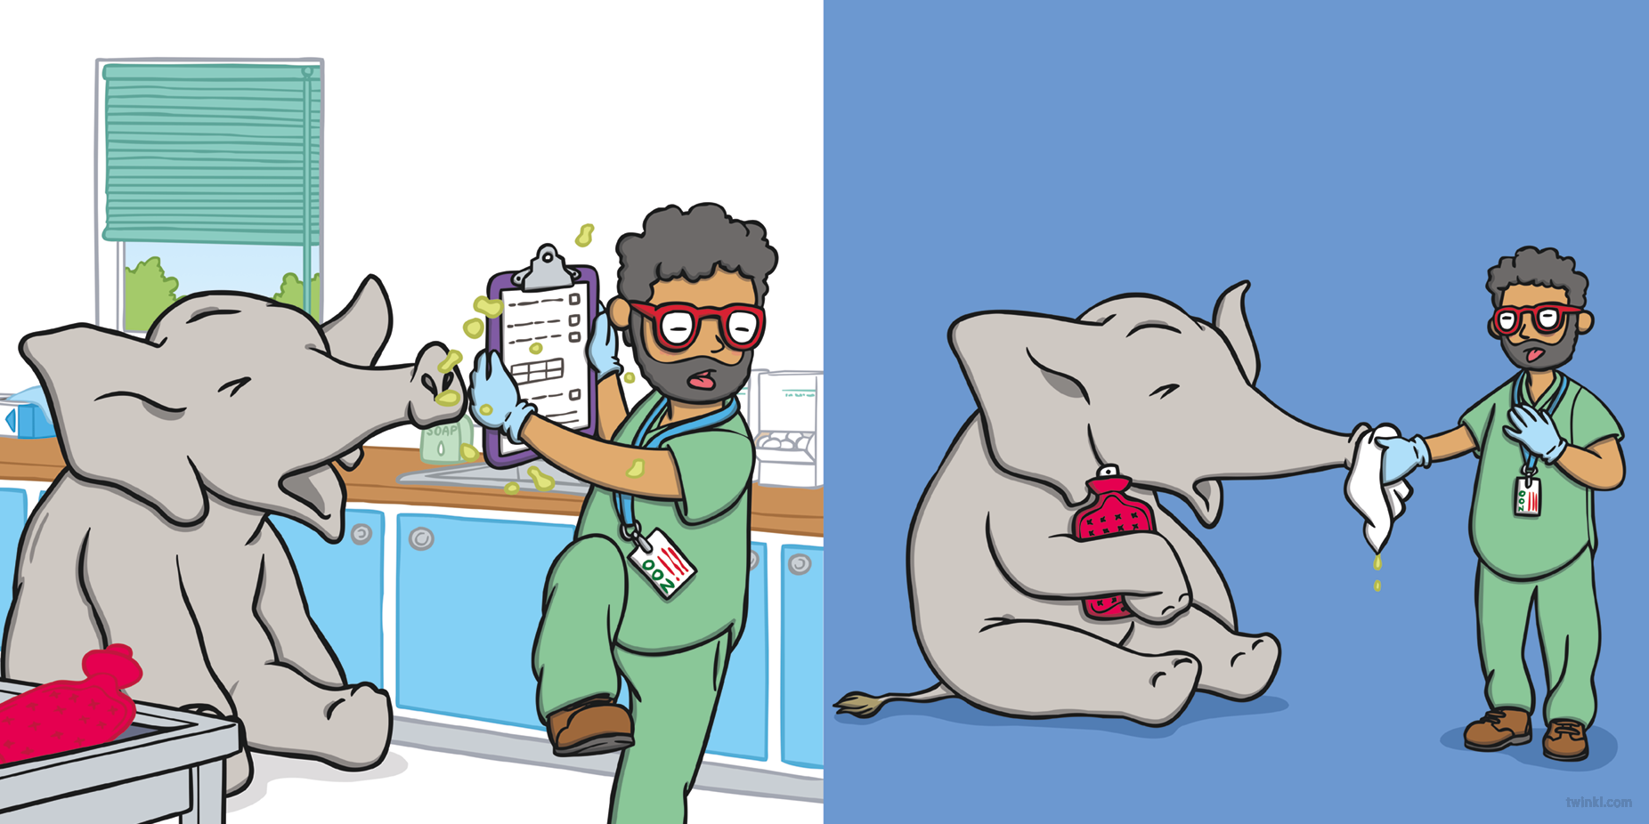
On Thursday, Eric the elephant visited the vet. He had a bad cold.
The vet gave Eric a big hankie and a hot-water bottle.

Slide 10
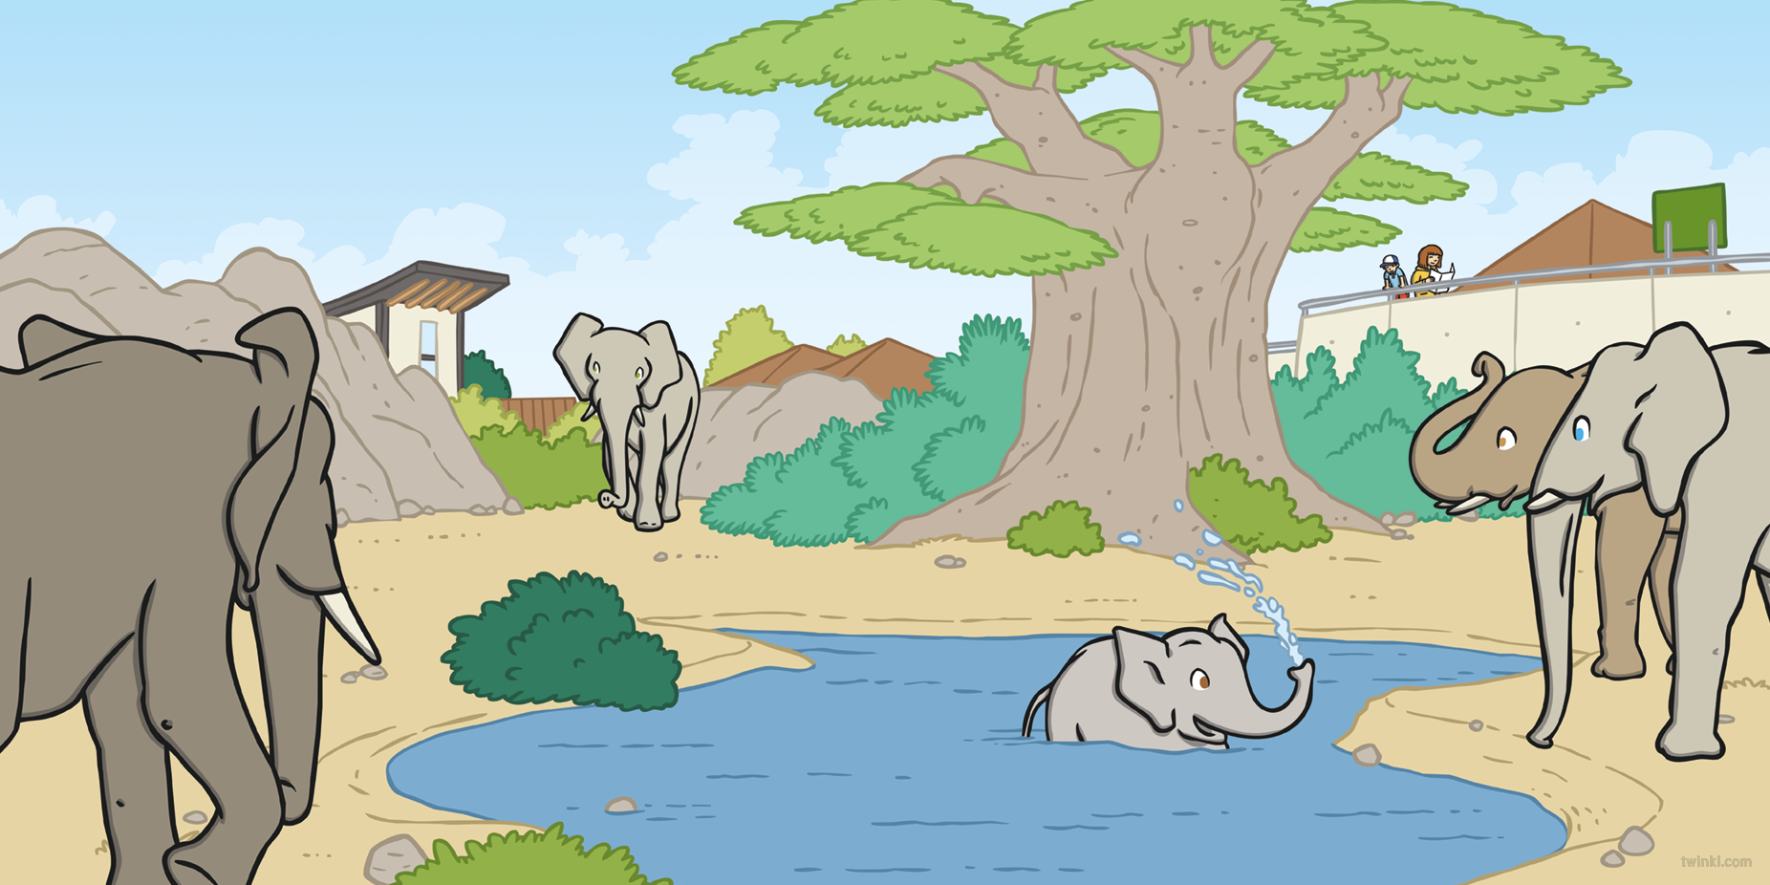
Thanks to the vet, the patient soon began to feel much better.

Slide 11
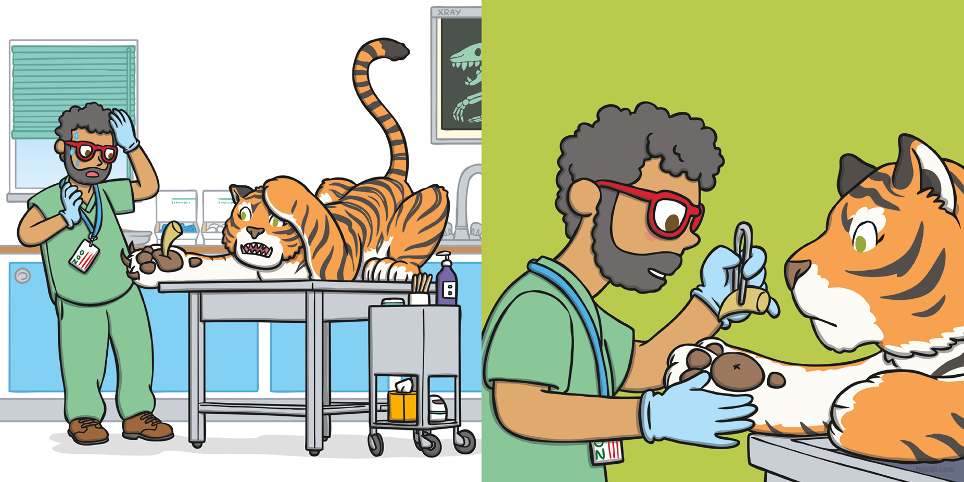
On Friday, Tori the tiger visited the vet. She had
a thorn stuck in her paw.
The vet pulled the thorn out of Tori’s paw and wrapped it in a bandage.

Slide 12
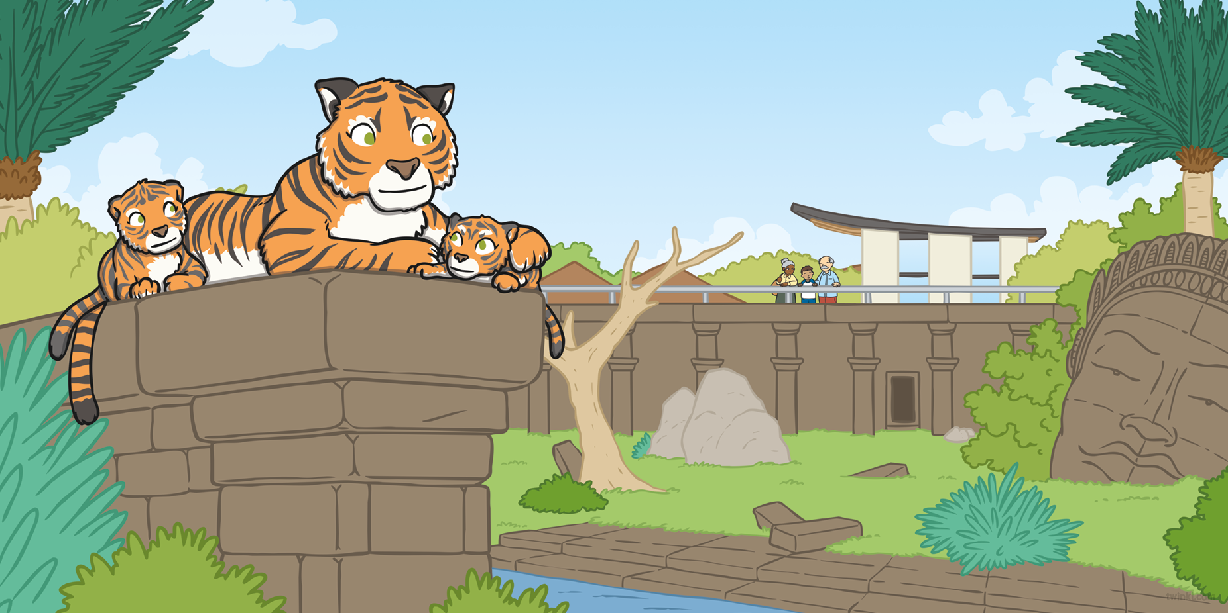
Thanks to the vet, the patient soon began to feel much better.

Slide 13
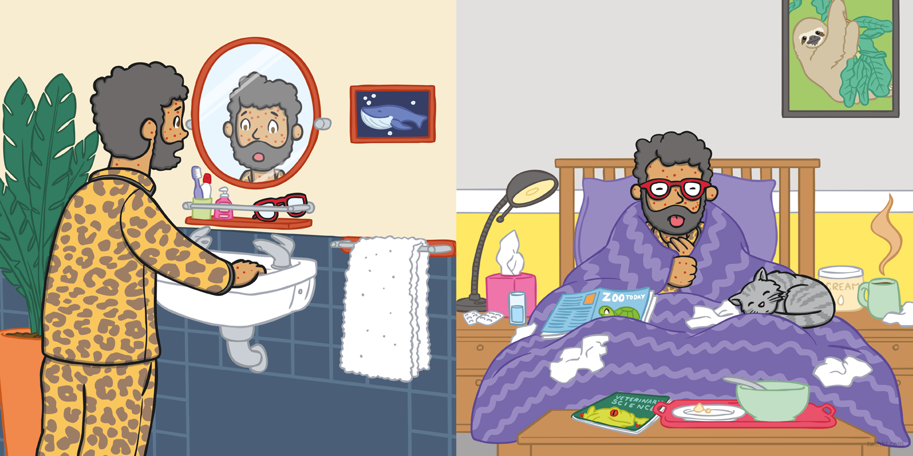
Oh no!
On Sunday, he put some cream on his spots and got plenty of rest…
On Saturday, it was the vet who was feeling poorly!

Slide 14
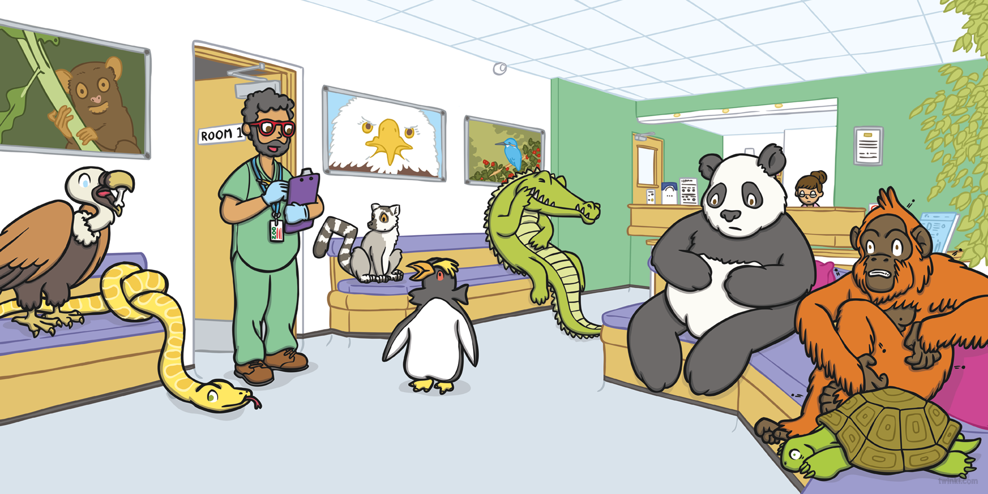
…and soon began to feel much better!

Slide 16
